Slide 1

PARKING LOT
RICHA VERMA – 2K18/IT/095
RHYTHM ARYA – 2K18/IT/094

Slide 2


WHY did we ch se THIS PR JECT?
Parking is a major concern in India.
Small villages and cities here lack basic parking technologies.
We intended to create a parking lot management system which can be deployed and used by the people.

Slide 3
INTR DUCTI N
Parking Lot System is based on a concept to generate and maintain parking details with their total charge. In India, there is no proper infrastructure, rules or regulations regarding the maintenance of parking lots. Although automated parking lots exist in some posh areas, the basic facility of maintaining a parking lot in most of the areas is rarely seen. So this project is merely a suggestion how we can implement the basic record of vehicles being parked along with some necessary details.

Slide 4
LANGUAGE AND T LS
C++
C++ language was used in this project due to the fact that we can implement various features such as:
Use of OOPs concepts
File Handling to store the details
Use of various classes and user-defined functions.

Slide 6

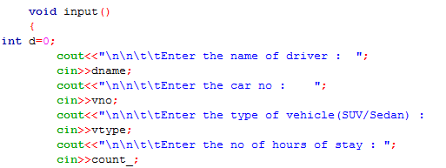
OBJECTIVE :
The main objective of this project on Parking lot is to manage the details :
Driver Name
Duration of Parking
Type of car
Area of Parking depending upon type of car

Slide 7

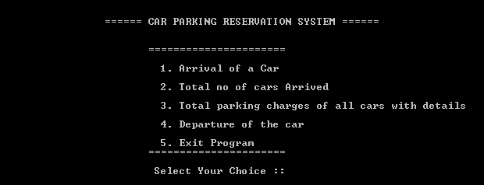
A menu driven code ….
On selecting different options different functions will be performed

Slide 8
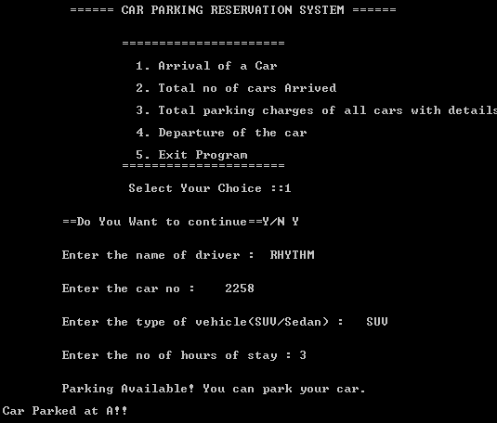
ON CHOOSING OPTION 1
On choosing option 1, customer comes and enter the required details if he satisfies the condition for parking the car is parked at a given block depending on the type of car..

Slide 9
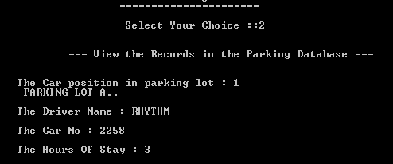
Option 2 will display the Records in the Parking Database along with the position of the car

Slide 10

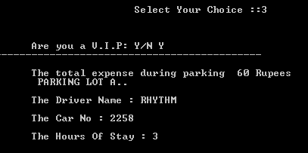
Option 3 calculates and display the parking charges depending upon VIP or a non VIP customer

Slide 11

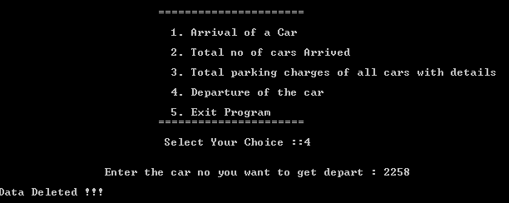
Option 4 deletes the record once the car is departed !!

Slide 12
FURTHER IMPR VEMENTS
No project is perfect and we fully accept that this is not a fully-fledged application upon which people could rely upon to ease the problem of maintaining the data in parking lots. Hence, improvements which we can make in this project given the opportunity can be:
Connecting it with an online server and database
Creation of a GUI in order to make it user-friendly and easy to use
Sharing the recorded data with police and other authorities in order to help them trace culprits in case of vehicle-related crimes.
And many more…

Slide 13
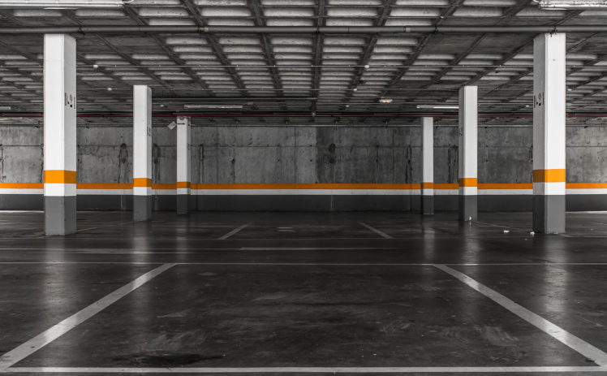
Thank You!

Slide 14
IDEA
KYU KIA
TUNE KYA LANGUAGE USE KI
USKE FEATURES
KYA CHEEZ BANAYI WORKING
CLASS FUNTION ,MEMBERB FUNTIONS
WORKING

